Slide 1
Lecture 14: Conversion of DFA to RE(Iterative Method/ State Elimination Method)
Agenda:
Iterative Method of Conversion of RE to DFA
Algorithm
Example
Presented by
Prof. Vaibhav Narayan Chunekar
K. J. Somaiya College of Engineering, Vidyavihar, Mumbai

Slide 2
Method of Conversion of DFA to RE
There are two methods to convert FA to regular expression –
DFA to RE
State Elimination Method / Iterative Method
Arden’s Theorem

Slide 3
Iterative Method of Conversion of DFA to RE
GNFA is an NFA with transition being label by regular expression .
When to accept String by this GNFA?
Definition➔ GNFA is said to accept string w if w can be written as concatenation of w=w1.w2........wk, there exist state qo ,q1 q2,....qk GNFA such that
Q0➔ Start State Qk➔ accept state
For all i of Ri is label at transition qi-1 to qi then wi is the element of L(Ri).

Slide 4
Without Loss of generality we may assume the followings:
1.GNFA has unique accept state
2. There are no incoming transition to start state and no outgoing transition from the accept state.(Unique start state Qs )
3. There are transition from start state to every other state and from every state to the accept state . (Keep Phi on Transition)
4. There is transition between every pairs of state that are not start or accept state.

Slide 5
Algorithm
Convert DFA to a GNFA in the appropriate form. Start State and global accept state.
Remove each internal state (not start/accept state) with each iteration.

Slide 6
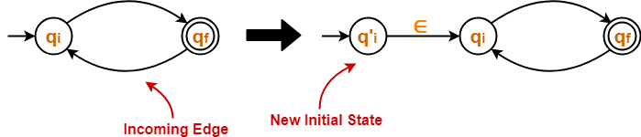
State Elimination Method
The state elimination method can be applied to any finite automata viz. (NFA, ∈-NFA, DFA etc)
This method involves the following steps in finding the regular expression for any given DFA-
Step 1:
Thumb Rule: The initial state of the DFA must not have any incoming edge.
If there exists any incoming edge to the initial state, then create a new initial state having no incoming edge to it.

Slide 7
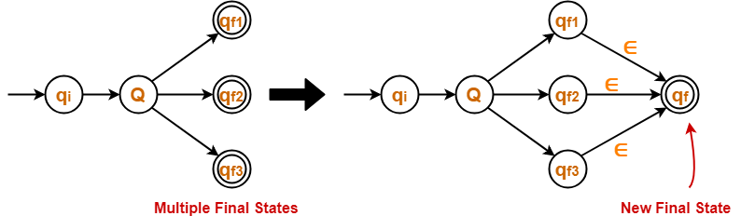
State Elimination Method : Step-02
Thumb Rule: There must exist only one final state in the DFA.
If there exists multiple final states in the DFA, then convert all the final states into non-final states and create a new single final state.

Slide 8
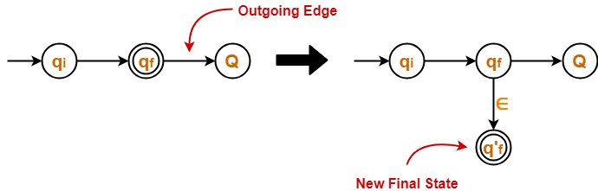
State Elimination Method : Step-03
Thumb Rule: The final state of the DFA must not have any outgoing edge.
If there exists any outgoing edge from the final state, then create a new final state having no outgoing edge from it.

Slide 9
State Elimination Method : Step-04
Eliminate all the intermediate states one by one.
These states may be eliminated in any order.
➔In the end,
Only an initial state going to the final state will be left.
The cost of this transition is the required regular expression.

Slide 10
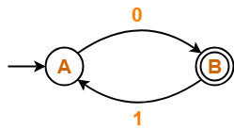
EXAMPLE OF CONVERTING DFA TO REGULAR EXPRESSION-
Example 1:

Slide 11
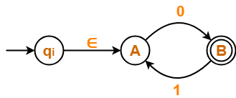
Step-01:
Initial state A has an incoming edge.
So, we create a new initial state q_{i}.

Slide 12
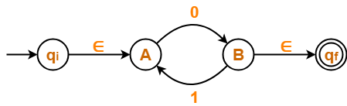
Step-02:
Final state B has an outgoing edge. So, we create a new final state q_{f}. The resulting DFA is-

Slide 13
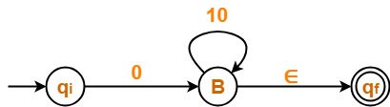
Step-03:
Now, we start eliminating the intermediate states.
First, let us eliminate state A. There is a path going from state q_{i} to state B via state A.
So, after eliminating state A, we put a direct path from state q_{i} to state B having cost ∈.0 = 0
There is a loop on state B using state A. So, after eliminating state A, we put a direct loop on state B having cost 1.0 = 10.
Eliminating state A, we get-

Slide 14

Step-04:
Now, let us eliminate state B.
There is a path going from state q_{i} to state q_{f} via state B.
So, after eliminating state B, we put a direct path from state q_{i} to state q_{f} having cost 0.(10)*.∈ = 0(10)*
Eliminating state B, we get-

Slide 15
Regular Expression = 0(10)*

Slide 16
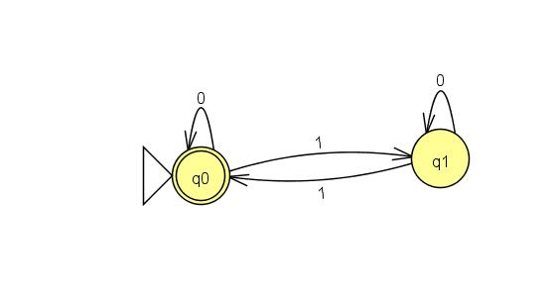
Example 2: DFA TO RE

Slide 17
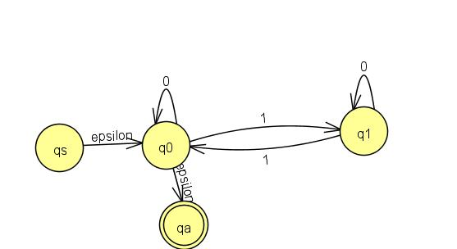
Removal of q1

Slide 18
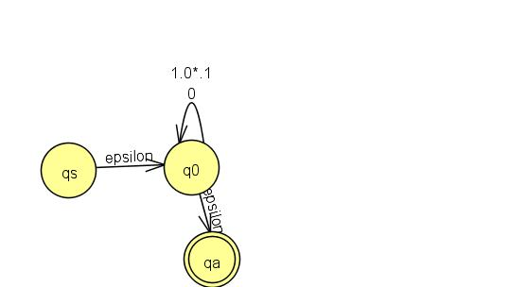
Removal of q0

Slide 19
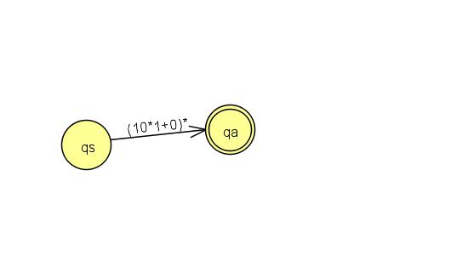
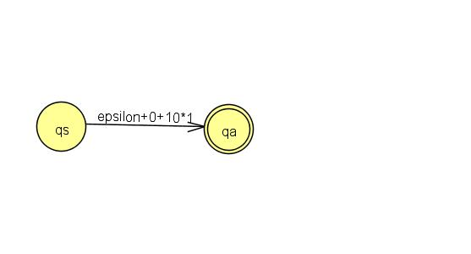
Final Regular Expession

Slide 20
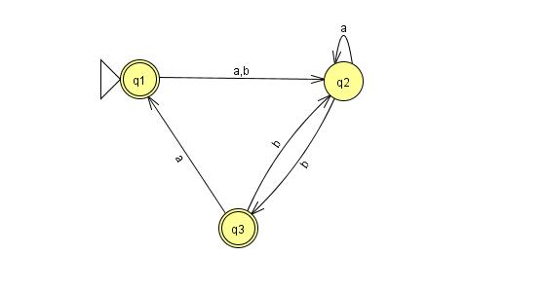
Example 3: DFA TO RE

Slide 21
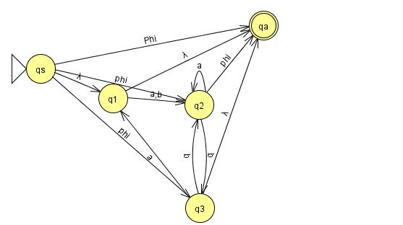
Create Start State and global accept state.

Slide 22
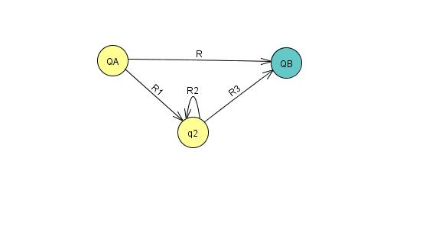
Example of How to Remove one internal state
➔ R + R1. R2*. R3

Slide 23
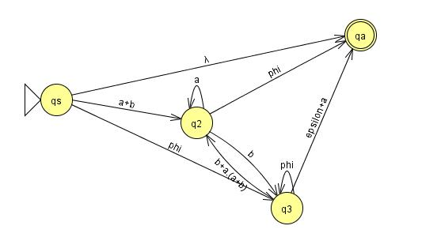
How to remove state q1

Slide 24
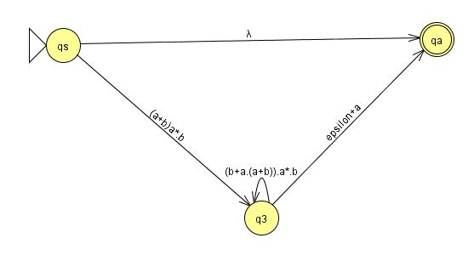
How to remove state q2

Slide 25
Thanks !!!
Any Query???

Slide 26
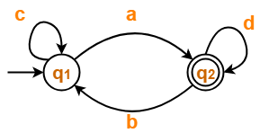
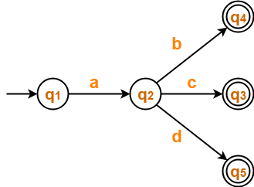
Home Assignment: Convert following DFA into RE:

Slide 27
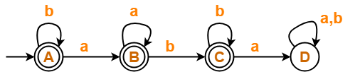
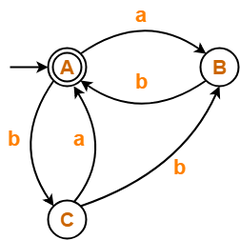
Home Assignment: Convert following DFA into RE:

Slide 28
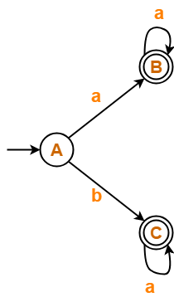
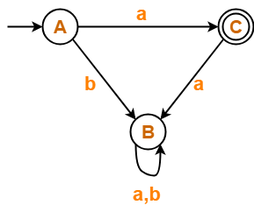
Home Assignment: Convert following DFA into RE:

